Slide 1
Generate SQL Query Hierarchically
孙培艺 1500012899 信科学院
张煌昭 1400017707 元培学院

Slide 2
Overview
Quick review of SQLNet & Seq2SQL.
Quick introduction of PHPs
Hierarchical SQL generation.
An example.
Training algorithm.
Advantages & shortcomings.

Slide 3
SQLNet & Seq2SQL
Split one single sequence of a simple SQL query into several sub-sequences.
E.g. SELECT xxx FROM xxx WHERE xxx.
Carefully design modules to generate each sub-sequence independently.
E.g. Aggregation operation module, SELECT column module, etc.
Use reinforcement learning to ‘compute’ the training loss.
E.g. Error SQL – -1; wrong result – 0; correct result -- +1;

Slide 4
SQLNet & Seq2SQL
√
SELECT column FROM table WHERE a=b and c>d
SELECT COUNT(column) FROM table WHERE a=b
SELECT column FROM
(SELECT xxx FROM xxx WHERE xxx) as table WHERE xxx
These models are too weak. They can only generate SQL sequences for those really simple queries.
No nested SQL, no complicated SQL, etc.
√
×

Slide 5
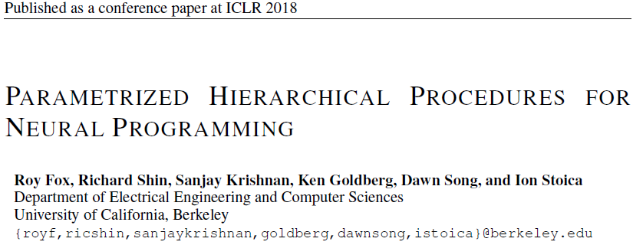
PHPs – Inspiration of our idea

Slide 6
PHPs
PHPs – Parametrized Hierarchical Procedures
‘Programs are hierarchy of procedure calls’.
Procedures are allowed to invoke other low-level procedures(e.g. function call), or take one action (e.g. SL/SR in a Turing machine).
WRITE
write
ADD
CARRY
carry
ROOT
WRITE
write
ADD
CARRY
carry

Slide 7

Hierarchical SQL Generation
What would a man do, when he was asked to translate NL to SQL?
DEVIDE AND CONQUER!
Normally, he would draw a draft first.
Then he carefully fill those easy blanks in his draft, and draw some detailed drafts for those complex blanks.
At last, the draft is complete.

Slide 8
Hierarchical SQL Generation - 2
Apply the idea of procedures.
Each procedure generate a sequence, consisting of invokings of lower-level procedures and SQL tokens.
Procedures can only invoke other grammatically correct procedures. The implementation is to apply a constraint on the vocabulary.
The ROOT procedure is allowed to invoke the ROOT’ procedure, which has all privileges of ROOT except for invoking ROOT’ itself.
Substantially, we want to generate the SQL syntax tree.

Slide 9
Hierarchical SQL Generation - 3
Each non-ROOT procedure is a seq2seq decoder, which combines the Ptr-net decoder and the LSTM decoder.
Ptr/token selection is controlled by a softmax gate.
The pointer chooses one token in the input sequence.
The token generation module generate one token in the vocabulary.
The ROOT procedure is a complete seq2seq encoder-decoder pair.
The ROOT procedure encodes the input sequence
Then, it generates the skeleton sequence, and sets the initialization state for each procedure it invokes, based on its encoding.

Slide 10
An Example
agg op
select
AGG
column
ROOT generates the ‘skeleton’ for the entire SQL query.
Level 1 procedures generate the ‘skeleton’ for their specific domains.
Low level procedures fill and complete the query.
Nested SQLs are allowed, by invoking ROOT’ procedure.
SELECT
… …
from
column
TABLE
table
ROOT
ROOT’
Nested SQL
column
CLAUSE
comp
where
and
value
WHERE
CLAUSE
… …
group by
column
…
GROUP
column

Slide 11
Training Algorithm
Gradients: DB, NL queries, SQL queries, SQL frontend compiler.
The SQL frontend compiler translates the SQL query to the procedure invoking hierarchy.
Use the frontend compiler to generate dataset for each kind of procedure from the raw dataset.
Top-down train each procedure, from ROOT to the lowest-level procedures.
Use CE to compute losses for the upper procedures.
Use RL to compute the losses for the lower procedures.

Slide 12
Advantages & Shortcomings
Advantages
Universal – Theoretically, this hierarchical model is capable to generate SQL without any constraints.
Imitation – This hierarchical model ‘imitates’ human behaviors in SQL query generation.
Shortcomings
Lack of dataset – The current datasets are often too small, and always too simple
Language dependent – The model cannot be transferred from one SQL language to another (e.g. MySQL to SQLServer), because the grammars are different.

Slide 13
THANK YOU!

